Slide 1
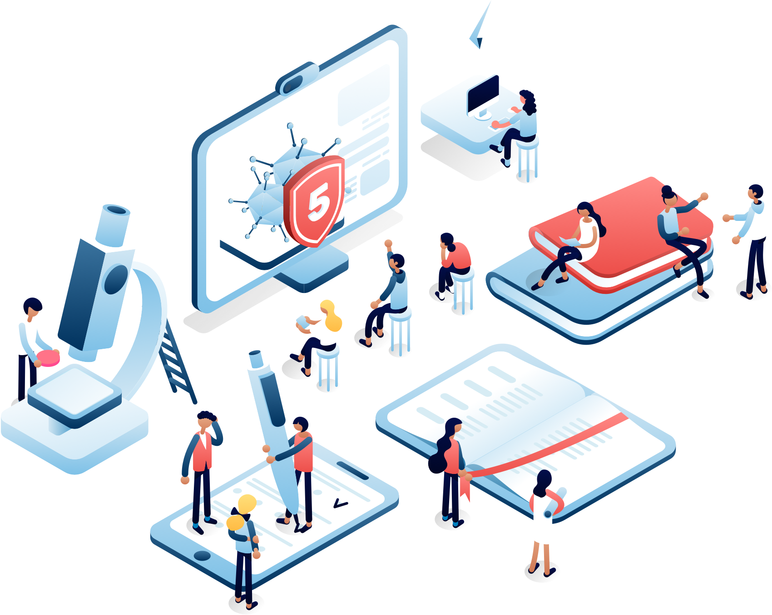
Your Logo
5 Ways to Prepare Your Business & Digital Presence
FOR CORONAVIRUS

Slide 2
The coronavirus is affecting businesses of all sizes all over the world. Fewer people are traveling, in-store traffic is down, and events of all kinds are being canceled.
However, there are steps you can take to improve and expand your digital presence that may help mitigate the fallout in this challenging time.
Your Logo
Now is the time to be proactive

Slide 3

Your Logo
Here are 5 steps
we recommend

Slide 4
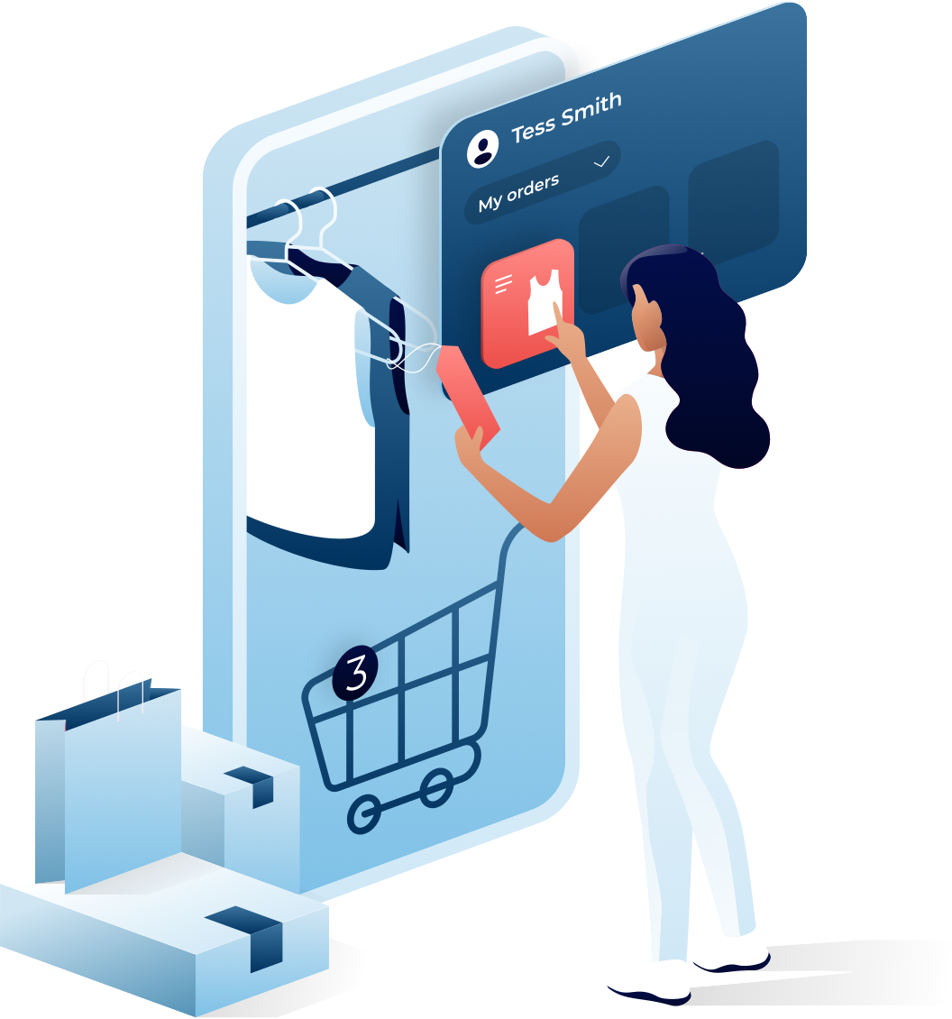
Your Logo
Prepare for more online transactions
As physical visits to stores and business locations decline, a strong eCommerce solution provides an additional source of revenue
We can create an omni-channel eCommerce presence with an online store customers can access through your website, Facebook page and more

Slide 5
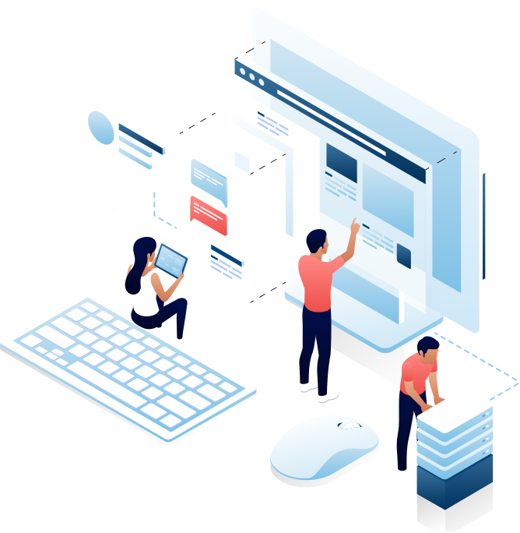
Your Logo
Prepare your website
Display messaging on your homepage about any service changes
Add features for scheduling (or rescheduling) in-person appointments
Add online payment and online transaction capabilities to existing websites

Slide 6

Your Logo
Create more digital content
Since you may not see your customers in-person as much, it’s important to remind them you’re still around and ready for their business. We can create a variety of materials that will keep you top of mind with your customers, including:
Blog posts
Update videos
Newsletters
Webinars

Slide 7




During an ongoing event like coronavirus, social media is one of your best tools for keeping your customers updated with the latest news from your business. Through social media monitoring you may also pick up on unique opportunities your business has to accommodate your customers’ needs during this challenging time.
Let’s create your plan now.
Your Logo
Engage more on social media

Slide 8

Your Logo
Consider Larger Projects
If you’ve recently thought about large scale changes to your website or online presence, now may be the ideal time to make them. This way when customers are ready to return, your digital presence is fresh and ready to convert more customers than ever.
Key Project Ideas:
Website redesign
SEO improvements
Security, accessibility & privacy

Slide 9

Contact us today!
Your Logo
Let us know how we can help
www.yoursite.com
your@email.com
555.555.5555

